Slide 1
Marketing Campaign ROI Analysis – GlowUp
Marketing Campaign ROI Analysis Report – GlowUp
Highest ROI Campaign: Email Boost
Lowest ROI Campaign: Diwali Blast
Average ROI: 484.32%
Average CPA: ₹391.78
Insights:
- Social Media & Influencer campaigns performed strongest.
- Email campaigns generated high leads but lower conversions.
- Events produced good brand visibility but moderate ROI.
Recommendations:
1. Increase budget allocation to Social Media & Influencer campaigns.
2. Optimize Email campaign creative and targeting.
3. Reduce low-impact Event costs and focus on digital channels.

Slide 2
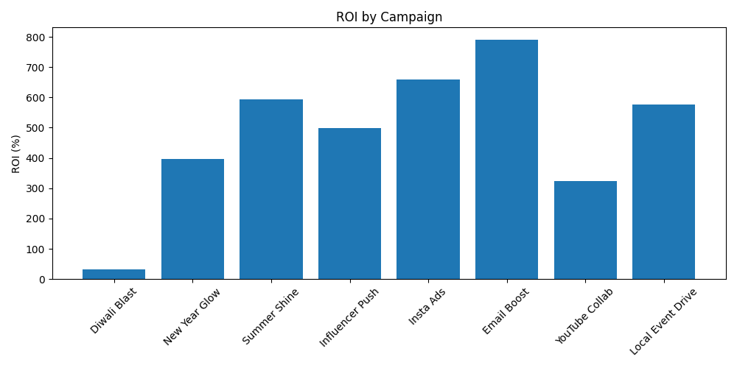
ROI by Campaign

